Slide 1
Dreams, Dreaming and the Subconscious

Slide 2
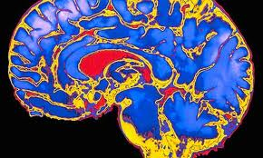
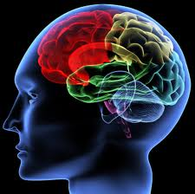
“You have been entrusted with the care and feeding of the most extraordinary and complex creation in the universe.
Home to your mind and personality, your brain houses your cherished memories and future hopes.
It orchestrates the symphony of consciousness that gives you purpose and passion, motion and emotion.”
But what do you really know about it ?
(Quote from Franklin Institute for Science Learning)
Notes:
http://www.quantumconsciousness.org/presentations/whatisconsciousness.html

Slide 3
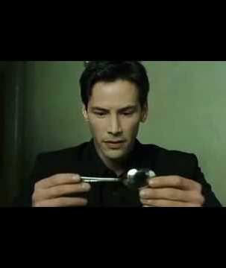
Is it possible to share thoughts? Can we share dreams?
Notes:
The Matrix

Slide 4
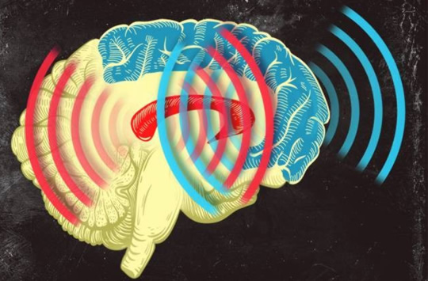
Synchronized Brain Waves enable rapid learning; new research 2014
Professor Earl K. Miller, MIT neuroscientist,
“If you can change your thoughts from moment to moment, you can’t be doing it by constantly making new connections and breaking them apart in your brain. Plasticity doesn’t happen on that kind of time scale.
There’s got to be some way of dynamically establishing circuits to correspond to the thoughts we’re having in this moment, and then if we change our minds a moment later, those circuits break apart somehow.” Category-learning results in new functional circuits between these two areas, and these functional circuits are rhythm-based…
When learning, the brain produces beta waves.
The striatum activates first, sees the pieces of the puzzle, then the prefrontal cortex puts the pieces together, working in sync with the striatum.
Prefrontal Cortex (blue)
& the Central Executive
Striatum (red)
Memory formation
Notes:
When learning, the brain produces beta waves. The striatum activates first, sees the pieces of the puzzle, then the prefrontal cortex acts and puts the pieces together, working in sync with the striatum. Category-learning results in new functional circuits between these two areas, and these functional circuits are rhythm-based,

Slide 5
Coma patients

Slide 6
MRI: your brain watching a movie
Harry Potter
https://www.youtube.com/watch?v=7yjHiVfMSHk&list=UUbDdmTlTwoCUx2p7nScbUCw&index=10
Avatar
http://www.youtube.com/watch?v=KSKIkXvqruI&list=UUbDdmTlTwoCUx2p7nScbUCw&index=4&feature=plcp
Alice in Wonderland https://www.youtube.com/watch?v=1BWWkXdOui4&index=5&list=UUbDdmTlTwoCUx2p7nScbUCw

Slide 7
If a tree falls in your dream, why does it make a sound?

Slide 8
MEMORY
Stages of memory
Encoding
Storage
Retrieval
Kinds of Memory
Short-term memory
Working memory
Long-term memory (Explicit and implicit)
Systems for Consolidation
Synaptic consolidation (within minutes)
Systems consolidation (while we’re sleeping)
Updating and Reconsolidation (weeks, even years later)

Slide 9
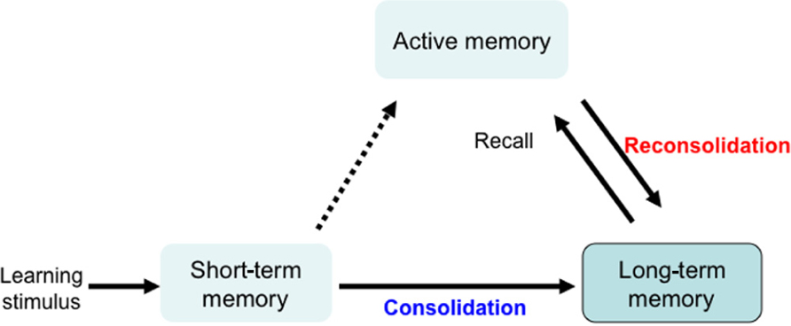
Memory Systems
Synaptic consolidation- within a few hours of learning
(when awake)
Systems consolidation- over days, weeks, maybe months
(when we’re asleep)
Even years later
Memory reconsolidation and Updating consolidation

Slide 10
How does the brain choose what memory to consolidate?
“TAGS”
If not tagged, sleep will forget memories it decides you don’t need
How to make sleep cement a memory?
For example: If you think you will be tested, your brain will remember it
Tags might be:
emotional
you were excited about it
pleasurable
made you happy
When does sleep consolidate memory?
In stage 3 and 4 deep slow-wave sleep (Non-rem sleep)

Slide 11
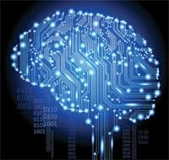
Memory
3 kinds of memory and memory systems:
Short term- active memory
7 things
7 seconds – 30 seconds
Long term- is stored memory
About 86 billion neurons in a brain
Sensory- from senses and experiences
Muscle memory
Explicit (declarative) Conscious
Implicit (procedural) Subconscious
Memory is:

Slide 12
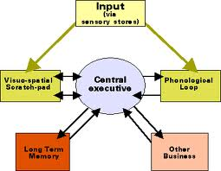
Memory
Working Memory
Central Executive, Prefrontal lateral cortex (PFC)
WM includes Short Term Memory
Attention
But not all memory goes
to long term Memory
Some memories are never in dreams- can you guess why??

Slide 14
Explicit Memory/Declarative
Declarative Memory: information you consciously recall and can explain
Episodic (long-term)
Long term memories of specific events, Specific
Autobiographical
Emotional
Includes flashbulb memory
such as when you won a championship, got your license, broke your arm
Semantic (long term)
Memories of facts, concepts, names, and other general information.
General knowledge..
Not unique to individual
The sky is blue. Grass is green. Crayons come in many colors

Slide 15
Implicit Memory/nondeclarative
Things that we don't purposely try to remember are implicit
both unconscious and unintentional.
sometimes referred to as nondeclarative memory because you are not able to consciously bring it into awareness
PRIMING:
If I wear Nike sneakers I can run faster
Pit bulls are dangerous dogs
Coke is better than Pepsi
PROCEDURAL:
Riding a bicycle
Making toast
EMOTIONAL:
I run into the house when I see a coyote
I jump up and clap and act crazy when Gronk scores a touchdown

Slide 16
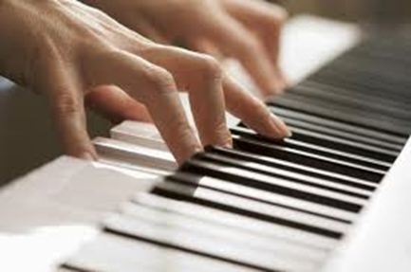
Clive Waring
He has no short-term memory but has implicit memory
Examples of fluctuating between two states of mind,
of being in another state of mind- (in the zone)- & in a 7 second state of awareness
https://www.youtube.com/watch?v=Vwigmktix2Y
His wife’s explanation of his passions https://www.youtube.com/watch?v=ymEn_YxZqZw

Slide 17
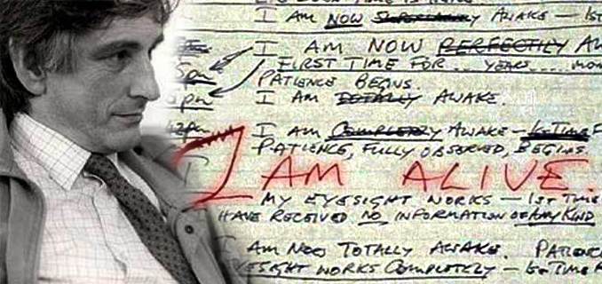
Clive Waring has retrograde amnesia- he’s lost many memories
& he has anterograde amnesia - he can’t create new memories
His hippocampus is damaged which means he can’t transfer memory from his short term memory to his long term storage

Slide 18
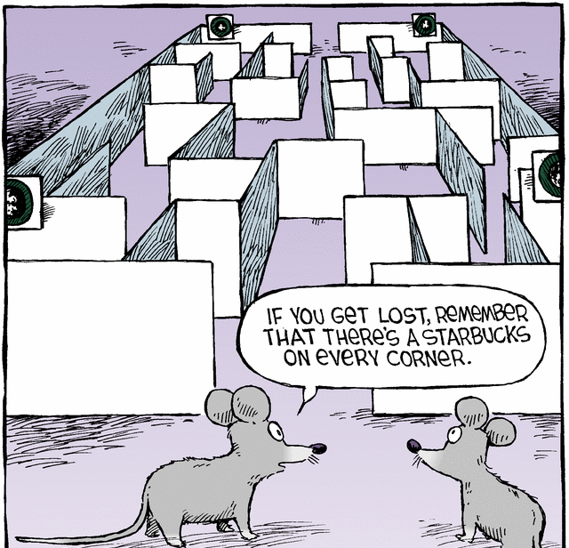
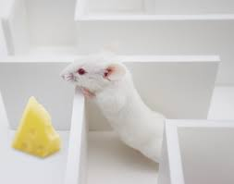
Theory (#2 of 6) Matt Wilson, MIT Center for Learning and Memory Dreams Create Wisdom
“Sleep turns a flood of daily information into what we call wisdom:
the stuff that makes us smart for when we come across future decisions”
we encode memory to long-term memory when we sleep
Dreams sort through memories, to determine which
ones to retain and which to lose.
His test: He put rats in mazes during the day & recorded what neurons fired in what patterns as the rats negotiated the maze. In REM sleep, the same neuron patterns fired that had fired at important turning points in the maze.
In other words, he saw that the rats were dreaming of important junctures in their day.

Slide 19
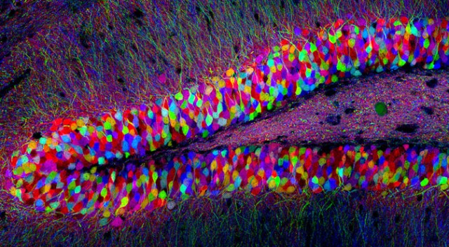
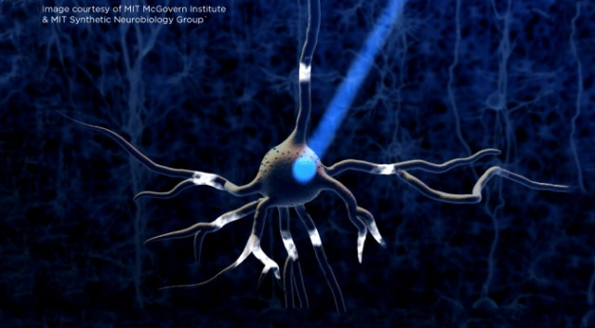
NEURONS: The Location of Memory
Memories are Physical: Not conceptual
When we have a new memory the gene Npas4, discovered at MIT, activates, turns on other
genes and changes the brain wiring
100+ genes control the formation of memories
A memory (engrams) can’t be erased
Neurons in the Hippocampus
Using Optogenetics
(light is used to control neurons)
Without the gene Npas4 we cannot form memories
Center for Neural Circuit Genetics at the Picower Institute for Learning and Memory at MIT
Notes:
New discovery: a different group of genes is used in memory processing than genes that are involved when the brain is in a resting state. Many of these had not previously been linked to any brain process
When you experience a new event, your brain encodes a memory of it by altering the connections between neurons. This requires turning on many genes in those neurons. Now, MIT neuroscientists have identified what may be a master gene that controls this complex process.

Slide 20
Sleep is important for memory
sleep before learning, is necessary because it prepares you to learn
the next day
sleep after learning is essential: it grabs onto the new information and cements the information in the neural architecture of the brain.
Sleep is like a save button, protects the memory and strengthens memory
Sleep intelligently cross links large sets of information, seeks out patterns, rules of all that information and creates novel insights.
Problem solving (the expression: sleep on it)
If sleep deprived, about 40% impairment in capacity to learn

Slide 21
MEMORY TRIAGE: (Acquisition | consolidation)
While we sleep our brain processes new information in a discriminatory manner
it picks and chooses what to keep
assimilates the memory into a
vast library of evolving knowledge
Encoding and Sleep Consolidation
Not everything is remembered-
For information that is retained, sleep integrates it into existing memory by:
looks for common patterns
Consolidates memories
Or, simply cement and strengthen the memory exactly as it was learned

Slide 22
Dream Theory # 1 The Evolutionary Theory We Dream to Practice Response to Situations Antti Revonsuo
Activity of the amygdala increases
The brain fires as if it’s in a
real life situation
The brain activity for motor skills increases- firing in a way that it’s practicing motor skills like running or jumping
In the safety of night, we practice survival skills
We rehearse fight or flight situations

Slide 23
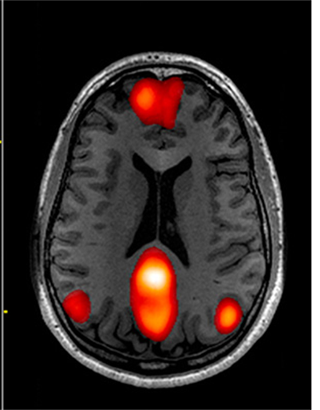
Dreams,
Daydreaming
& the Default Network
Clicks on when we stop focusing
Activation of the Default Network of structures has been linked to daydreaming
recollection of memories and imagining future
Restful relaxing when awake
Loosing yourself in your work
DMN is an ‘off-line’ kind of cognition and in this way is similar to dreams
REM sleep is very different from daydreaming
Amygdala more active in dreams than daydreaming or default network

Slide 24
Default Network Mode
Activates when the mind is idle
Daydreaming
Envision the future
Reflect on the past
Creates spontaneous thoughts
Activates less in people who experience long term trauma/PTSD
It’s a network that connects temporal lobe (memory), PFC (theory of mind) and cingulate and activates only as a default
Precuneus is at the hub of DNM
episodic memory
Self-awareness
Visual memory
Taking a third person perspective of one self
May be more active in lucid dreams
This is new research with much to be learned- not entirely accepted yet
Notes:
part of the medial temporal lobe for memory, part of the medial prefrontal cortex for theory of mind, and the posterior cingulate cortex for integration

Slide 25
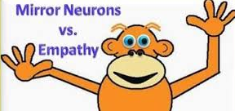
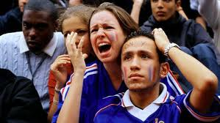
Mirror Neurons a fascinating new area in the early stages of study
Mirror neurons do not mean these neurons have a Theory of Mind/empathy
One theory is mirror neurons merely facilitate learning through imitation
The TPJ is not part of the mirror neuron network (Rebecca Saxe research)
Why do we cry at the movies?
See Monkey, See Monkey Do
http://www.pbs.org/wgbh/nova/education/body/mirror-neurons.html
Mirror Neurons and Intention
http://www.youtube.com/watch?v=Tq1-ZxV9Dc4
>>> Did he prime me to want water, or were my mirror neurons imitating him?
Podcasters, Stuff You Should Know explain mirror neurons:
http://science.discovery.com/tv-shows/stuff-you-should-know/videos/stuff-you-should-know-mirror-neurons.htm

Slide 26
Reality Attention Memory
why do dreams seem real?
Notes:
why do dreams seem real?

Slide 27
The attention span of a goldfish
Who has a longer attention span?
A typical person or a tech-savvie person or a goldfish?
Notes:
http://medicalxpress.com/news/2015-05-microsoft-human-attention-span-lags.html
In analyzing the data obtained, the researchers found that the average attention span for the respondents and volunteers was just eight seconds, down from twelve back in 2000, and one second shorter than the average goldfish. They also found that using digital devices has caused an improvement in multi-tasking skills.
there are three types of human attention:
sustained (prolonged focus),
selective (maintaining focus despite distractions)
alternating (shifting attention between tasks or stimuli).

Slide 28
ATTENTION
Sustained
Alternating/shifting
Selective
Ability to focus
like a highlighter helps us focus on certain
things and tune out others
Limited capacity
Multi-tasking
Part of our biology and helps us survive

Slide 29
Attention
Attention
Focusing
General resources
Specificity of resources
I didn’t hear you calling. I can’t listen
to everybody who yells at me.
William James
“Attention is the taking possession of the mind, in clear and vivid form… It implies withdrawal from some things in order to deal effectively with others."
Whodunit: https://www.youtube.com/watch?v=S9WC-vWCkkU
Quirk Video Magic Trick:
https://www.youtube.com/watch?v=v3iPrBrGSJM&list=PL1WmMN6zPoSznASYKavsMM9MScG14xNOl&index=84

Slide 30
Change Blindness A person can be unaware of something that is right in front of their eyes
there is simply too much information for
my brain to fully process and be aware
of every single thing that happens in my
immediate environment.
In many cases, big shifts can happen in your visual field and you are never even aware of these changes.
Psychologists refer to this as
change blindness.
Whodunit: https://www.youtube.com/watch?v=S9WC-vWCkkU

Slide 31
This is a test
University of Chicago Video : https://www.youtube.com/watch?v=IGQmdoK_ZfY

Slide 32
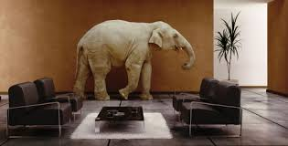
Change Blindness Why are we blind to change? If we miss the elephant in the room- What else do we miss?
Looking isn’t the same as seeing. You have to focus attention to be aware.
Dan Simons and the gorilla narrate about the study
http://www.youtube.com/watch?v=UtKt8YF7dgQ

Slide 33
DREAM Theory (#3 of 6) Francis Crick: Nobel in Physiology for discovering structure of DNA Dreaming is Like Defragmenting Your Hard Drive
"we dream in order to forget."
The brain is a machine that connects data in the same way as a matter of habit, (not always useful to do this)
When we sleep the brain fires more randomly and establishes new connections and pathways
Dreaming shuffles old connections that allows us to keep the important connections and erase the inefficient links
A good analogy here is the defragmentation of a computer's hard drive: Dreams are a reordering of connections to streamline the system
Notes:
offline optimization is needed, because if we do not have a periodic repair (while asleep) we (the brain) will become overly complex and dysfunctional.
Crick believes that REM dreaming represents a purging or pruning of superfluous associations and complexity in the cognitive system. “In short, taking the brain off-line to prune exuberant associations established during wakefulness may be a necessary price we pay for having a sophisticated cognitive system that can distil complex and subtle associations from sensory samples.”

Slide 34
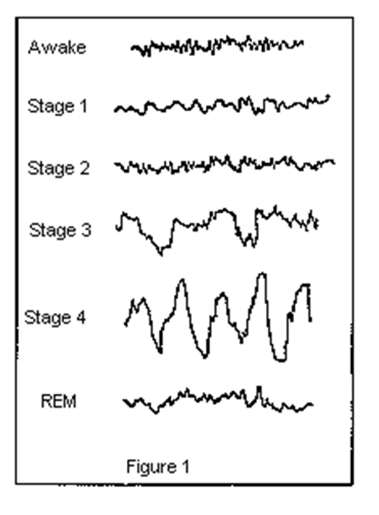
Brain waves in the stages of sleep

Slide 35
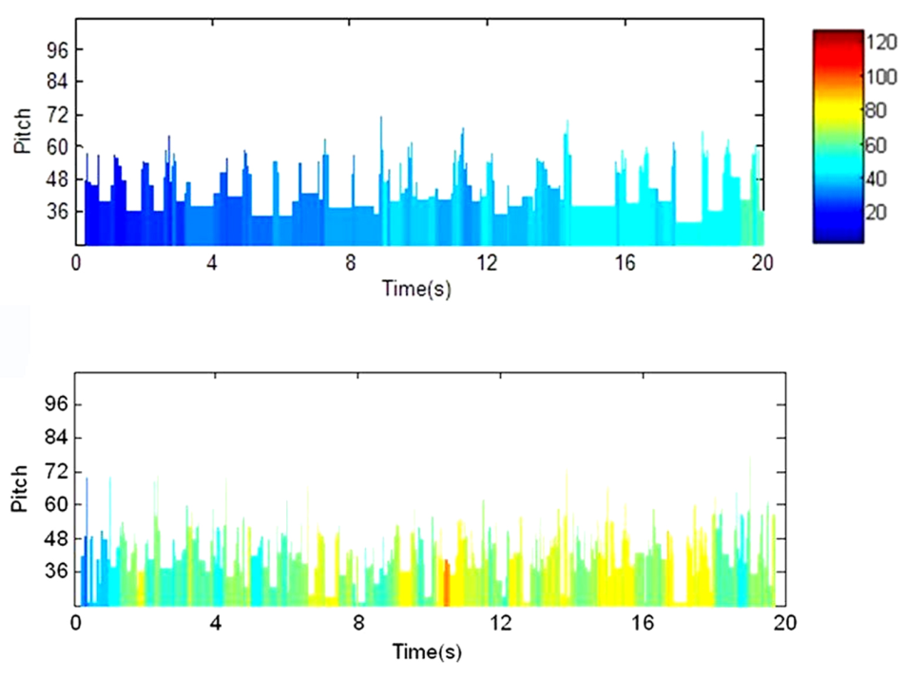
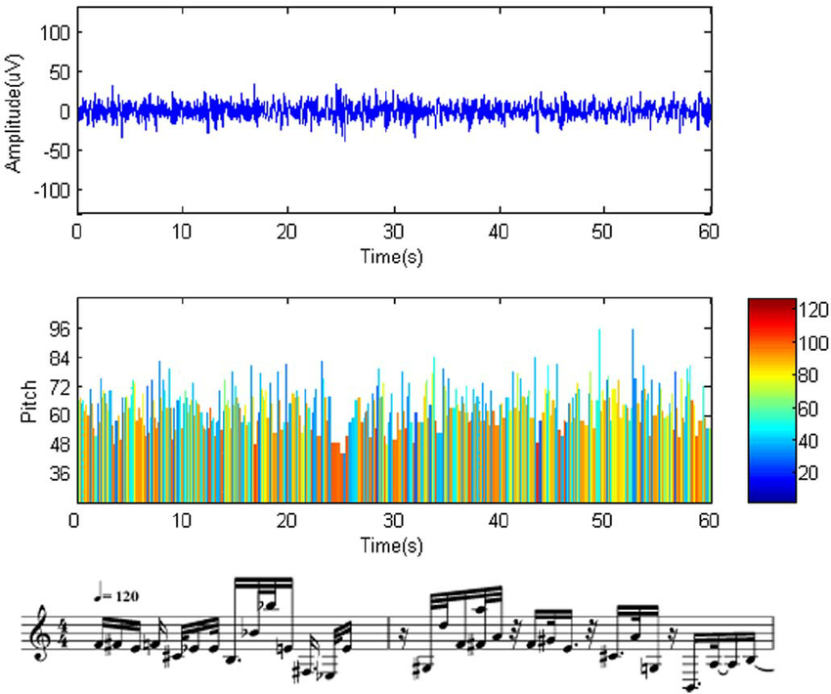
Brain waves are like musical notes
http://www.livescience.com/24778-a-little-brain-music-sounds-of-your-brainwaves-video.html
Notes:
Everything Seems to “Flow”

Slide 36
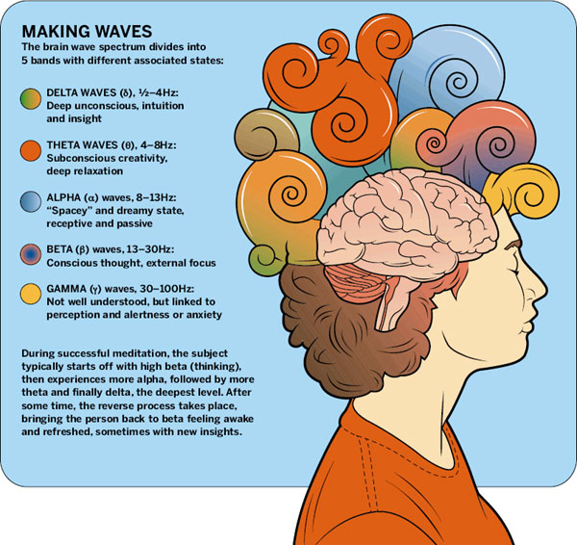
Brain waves

Slide 37
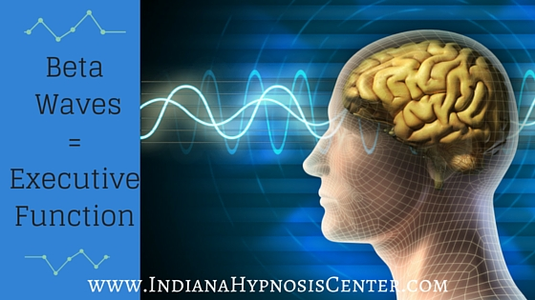
Beta Brain waves
Beta brain waves:
occur between 14 - 30 Hz
intense mental activity can reach 50 Hz conscious waking state
attentive and alert to external stimuli
higher state of alertness or tension,
When we exert specific mental effort- Not efficient takes require a lot of energy
Beta waves also occur during deep sleep, REM (Rapid Eye Movement) sleep when the eyes switch back and forth.
the amplitude of beta rhythms tends to be less than for alpha rhythms
does not mean that there is less electrical activity
the "positive" and "negative" activities counterbalance so that the sum of the electrical activity is less.
instead of getting the synchronized pattern of alpha waves, there is desynchronization or alpha block

Slide 38
Alpha Brain waves
Alpha brainwaves cycle between the frequency 8 Hz – 12 Hz.
They are synchronized and connect both hemispheres of your brain
can be found solely in the right hemisphere as well
Help mental coordination, calmness, alertness, mind/body integration and learning.
Typically when awake but eyes are closed
Deep state of Relaxed- Everything seems to flow
Creative State- Peacefulness- Meditative
Enhanced learning
Optimal athletic performance
Enhanced healing
Psychic experiences can happen in the alpha state.
Both daydreaming and sleep dreaming occur while in the alpha state.
Schumann Resonances – ELF of EM field spectrum
MAY THE FORCE
BE WITH YOU
Notes:
Everything Seems to “Flow”
Schumann resonances
ELF of the Earth’s electromagnetic field spectrum
Earth vibrates between Alpha and Theta

Slide 39
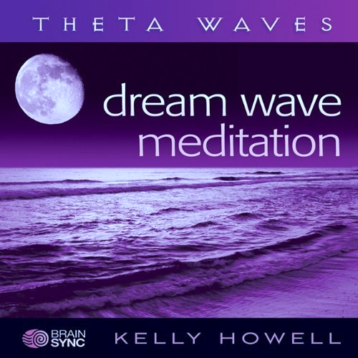
Theta Brain waves
Theta brain waves:
Theta brainwaves occur between 4 - 7 Hz
acts as our gateway to learning and memory
our senses are not connected with the external world
focused on signals from within
mental activity such as daydreaming, fantasy, imagination, ideas, inspirational thinking
most thoughtful experiences occur at the theta level
achieve enlightenment, and other dimensions with Theta waves
Also in dream state- vivid imagery, fears, nightmares
If you drive for a long while on a straight road, you can go into Theta state.
Notes:
Everything Seems to “Flow”

Slide 40
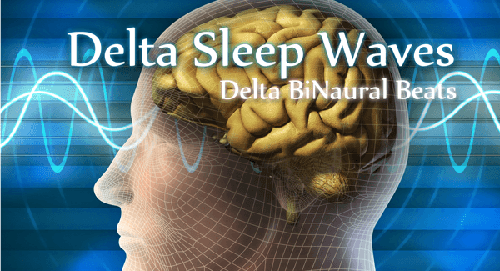
delta waves
Deep Sleep- but not dreaming
Healing and regeneration are stimulated
that is why deep restorative sleep
Delta waves suspend external awareness and are the source of empathy
Females have more delta wave activity (true for most mammal species. )
Infants spend much of their sleep in Delta Wave sleep (25% less age 10)
Delta Wave sleep decreases with age
show a lateralization, with right hemisphere dominance during sleep
Delta waves arise in the thalamus or in the cortex.
Delta activity stimulates the release of several hormones, including growth hormone releasing hormone GHRH (somatocrinin) and PRl (prolactin) GHRH is released from the hypothalamus which in turn stimulates release of the growth hormone from the pituitary
Intoxication decreases delta waves: delta wave disruption
Schizophrenics have much less delta wave activity

Slide 41
Delta Waves
Asleep- but not dreaming
Females have more delta wave activity (true for most mammal species. )
Infants spend much of their sleep in Delta Wave sleep (25% less age 10)
Delta Wave sleep decreases with age
delta waves show a lateralization, with right hemisphere dominance during sleep
Delta waves arise in the thalamus or in the cortex.
Delta activity stimulates the release of several hormones, including growth hormone releasing hormone GHRH (somatocrinin) and PRl (prolactin) GHRH is released from the hypothalamus which in turn stimulates release of the growth hormone from the pituitary
Intoxication decreases delta waves: delta wave disruption
Schizophrenics have much less delta wave activity
About 20% of our sleep is in deepest sleep

Slide 42
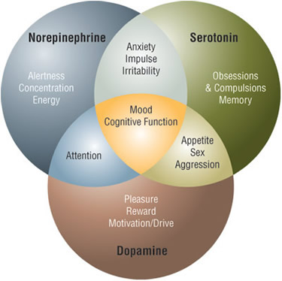
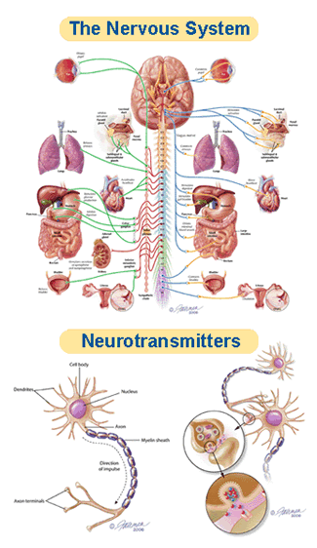
The Chemicals of Sleep… or not
Notes:
REM dreaming is characterized by low serotonin levels and high acetylcholine levels,(a neurotransmitter to the periphery and CN (central nervous system) norepinephrine
which may explain why dreams are so hard to remember: they are never encoded in short-term memory in the first place. When we wake up, serotonin floods the brain and our dream experiences from just a moment before are carried away by the tide.
Serotin- our happy hormone giving us ‘emotional balance’ etc. Regulates Mood, appetite, sleep, learning, helps formation of memories
Noradrenergic- release noraephrinene mobilizes us- hormone and chemical / transmitter which is highest when we’re in danger or under stress conditions, and lowest when we’re asleep

Slide 43
Chemicals and Sleep
neurotransmitters carry information between synapses
also control whether we are asleep or conscious
SEROTONIN: a neurotransmitter- our “happy hormone”
cognition
Enables learnong, processes and carries memories
NOREPINEPHRINEN- ( noradrenaline) our “reward system”
Stress hormone| fight or flight (amygdala)
cognitive alertness, attention, concentration
MELATONIN- circadian rhythm: our natural clock
ADENOSINE: it accumulates when we’re active
>breaks down quickly as we fall sleep
DOPAMINE: a neurotransmitter, controls sleep regulation.
Dopamine acts in the pineal gland, dictating the 'circadian rhythm‘
controls the brain's reward and pleasure centers.
Dopamine also helps regulate movement and emotional responses,
Notes:
Nerve-signaling chemicals called neurotransmitters control whether we are asleep or awake by acting on different groups of nerve cells, or neurons, in the brain. Neurons in the brainstem, which connects the brain with the spinal cord, produce neurotransmitters such as serotonin and norepinephrine that keep some parts of the brain active while we are awake. Other neurons at the base of the brain begin signaling when we fall asleep. These neurons appear to "switch off" the signals that keep us awake. Research also suggests that a chemical called adenosine builds up in our blood while we are awake and causes drowsiness. This chemical gradually breaks down while we sleep.

Slide 44
Why are dreams weird?

Slide 45
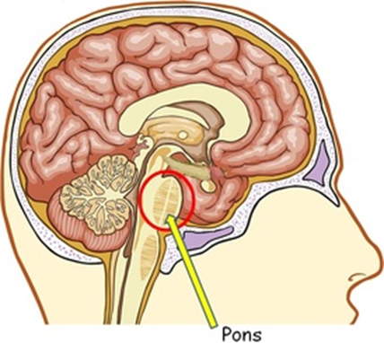
changes while we sleep
NREM stages
Body temperature drops, body relaxes
Metabolism drops, blood pressure drops
Immune systems kick in, growth hormones
Electro-chemical changes
serotonin, epinephrine and melatonin
REM
Pons activates the switch
Intense brain activity
Rapid breathing, Increase blood pressure and heart rate
REM paralysis
PFLC shuts off
No working memory
No serotonin and no noradrenalin
Activation synthesis

Slide 46
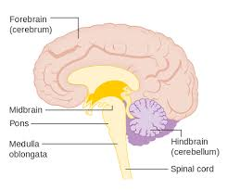
THE PONS
Area of the hindbrain directly above the medulla
Function: Neural Pathways- Connect upper and lower parts of the brain
message station between several areas of the brain- including the cortex and the cerebellum.
Without the pons, the brain would not be able to function because messages would not be able to be transmitted, or passed along.
REM sleep, the sleeping state where dreaming is most likely to occur, has been proven to originate in the pons

Slide 47
Stages of sleep: Non-REM
Your body rests
Body starts to manufacture growth hormones
Starts to make antibodies
N1 - Body rests
Alpha Waves
Stage One lasts about 5- 12 minutes
We hear things but don’t care unless it’s important
hypnic myoclonia
(similar to when we jump when startled)
N2- about 10 – 20 minutes
We can still hear, but we don’t understand
About half our sleep is stage 2
hypnogogic imagery
N3- Deep sleep- slow delta waves start
growth hormones
we don’t hear sounds in the house
Notes:
One cycle is about 90 minutes- 120 minutes:
N1 Our eyes move very slowly and muscle activity slows. People awakened from stage 1 sleep often remember fragmented visual images. Many also experience sudden muscle contractions called hypnic myoclonia, often preceded by a sensation of starting to fall. These sudden movements are similar to the "jump" we make when startled.
REM: The first REM sleep period usually occurs about 70 to 90 minutes after we fall asleep. A complete sleep cycle takes 90 to 110 minutes on average. The first sleep cycles each night contain relatively short REM periods and long periods of deep sleep. As the night progresses, REM sleep periods increase in length while deep sleep decreases. By morning, people spend nearly all their sleep time in stages 1, 2, and REM.
Amnesia: People awakened after sleeping more than a few minutes are usually unable to recall the last few minutes before they fell asleep. This sleep-related form of amnesia is the reason people often forget telephone calls or conversations they've had in the middle of the night. It also explains why we often do not remember our alarms ringing in the morning if we go right back to sleep after turning them off.
Catching up on REM: People lose some of the ability to regulate their body temperature during REM, so abnormally hot or cold temperatures in the environment can disrupt this stage of sleep. If our REM sleep is disrupted one night, our bodies don't follow the normal sleep cycle progression the next time we doze off. Instead, we often slip directly into REM sleep and go through extended periods of REM until we "catch up" on this stage of sleep. What Does Sleep Do For Us?
Although scientists are still trying to learn exactly why people need sleep, animal studies show that sleep is necessary for survival. For example, while rats normally live for two to three years, those deprived of REM sleep survive only about 5 weeks on average, and rats deprived of all sleep stages live only about 3 weeks. Sleep-deprived rats also develop abnormally low body temperatures and sores on their tail and paws. The sores may develop because the rats' immune systems become impaired. Some studies suggest that sleep deprivation affects the immune system in detrimental ways.
Sleep appears necessary for our nervous systems to work properly. Too little sleep leaves us drowsy and unable to concentrate the next day. It also leads to impaired memory and physical performance and reduced ability to carry out math calculations. If sleep deprivation continues, hallucinations and mood swings may develop. Some experts believe sleep gives neurons used while we are awake a chance to shut down and repair themselves. Without sleep, neurons may become so depleted in energy or so polluted with byproducts of normal cellular activities that they begin to malfunction. Sleep also may give the brain a chance to exercise important neuronal connections that might otherwise deteriorate from lack of activity.
Deep sleep coincides with the release of growth hormone in children and young adults. Many of the body's cells also show increased production and reduced breakdown of proteins during deep sleep. Since proteins are the building blocks needed for cell growth and for repair of damage from factors like stress and ultraviolet rays, deep sleep may truly be "beauty sleep." Activity in parts of the brain that control emotions, decision-making processes, and social interactions is drastically reduced during deep sleep, suggesting that this type of sleep may help people maintain optimal emotional and social functioning while they are awake. A study in rats also showed that certain nerve-signaling patterns which the rats generated during the day were repeated during deep sleep. This pattern repetition may help encode memories and improve learning.

Slide 48
Stages of sleep: Non-REM, cont.
N4 Deepest Sleep- your brain recharges
Also called Slow Wave Sleep
Delta-waves
Difficult to wake
Bed-wetting
Night terrors
Sleep walking
Growth hormones for children & young adults
Immune System kicks in
Repairs damages (inc. those caused by stress)
Beauty sleep
Consolidate memory
Encode memory (improves learning ability)
Sleep amnesia- we don’t remember phone calls, alarms, etc.
stage 3 and 4 are the longest part of sleep
Overall, about 20% of our sleep each night-
most of in the first occurs in the first two sleep cycles
Dream science experts believe most dreams are during REM sleep.
More recent science shows some dreams in non-rem sleep
Notes:
One cycle is about 90 minutes:
N1 Our eyes move very slowly and muscle activity slows. People awakened from stage 1 sleep often remember fragmented visual images. Many also experience sudden muscle contractions called hypnic myoclonia, often preceded by a sensation of starting to fall. These sudden movements are similar to the "jump" we make when startled.
REM: The first REM sleep period usually occurs about 70 to 90 minutes after we fall asleep. A complete sleep cycle takes 90 to 110 minutes on average. The first sleep cycles each night contain relatively short REM periods and long periods of deep sleep. As the night progresses, REM sleep periods increase in length while deep sleep decreases. By morning, people spend nearly all their sleep time in stages 1, 2, and REM.
Amnesia: People awakened after sleeping more than a few minutes are usually unable to recall the last few minutes before they fell asleep. This sleep-related form of amnesia is the reason people often forget telephone calls or conversations they've had in the middle of the night. It also explains why we often do not remember our alarms ringing in the morning if we go right back to sleep after turning them off.
Catching up on REM: People lose some of the ability to regulate their body temperature during REM, so abnormally hot or cold temperatures in the environment can disrupt this stage of sleep. If our REM sleep is disrupted one night, our bodies don't follow the normal sleep cycle progression the next time we doze off. Instead, we often slip directly into REM sleep and go through extended periods of REM until we "catch up" on this stage of sleep. What Does Sleep Do For Us?
Although scientists are still trying to learn exactly why people need sleep, animal studies show that sleep is necessary for survival. For example, while rats normally live for two to three years, those deprived of REM sleep survive only about 5 weeks on average, and rats deprived of all sleep stages live only about 3 weeks. Sleep-deprived rats also develop abnormally low body temperatures and sores on their tail and paws. The sores may develop because the rats' immune systems become impaired. Some studies suggest that sleep deprivation affects the immune system in detrimental ways.
Sleep appears necessary for our nervous systems to work properly. Too little sleep leaves us drowsy and unable to concentrate the next day. It also leads to impaired memory and physical performance and reduced ability to carry out math calculations. If sleep deprivation continues, hallucinations and mood swings may develop. Some experts believe sleep gives neurons used while we are awake a chance to shut down and repair themselves. Without sleep, neurons may become so depleted in energy or so polluted with byproducts of normal cellular activities that they begin to malfunction. Sleep also may give the brain a chance to exercise important neuronal connections that might otherwise deteriorate from lack of activity.
Deep sleep coincides with the release of growth hormone in children and young adults. Many of the body's cells also show increased production and reduced breakdown of proteins during deep sleep. Since proteins are the building blocks needed for cell growth and for repair of damage from factors like stress and ultraviolet rays, deep sleep may truly be "beauty sleep." Activity in parts of the brain that control emotions, decision-making processes, and social interactions is drastically reduced during deep sleep, suggesting that this type of sleep may help people maintain optimal emotional and social functioning while they are awake. A study in rats also showed that certain nerve-signaling patterns which the rats generated during the day were repeated during deep sleep. This pattern repetition may help encode memories and improve learning.

Slide 49
Parasomnia (sleep disorders)
Sleep Talking (Somniloquy)
Sleep Walking
Sleep Eating
Night Terrors
Narcolepsy
Sleep Paralysis
Seeing Ghosts
Hypnic jerk (predormital myoclonus)
These happen when we’re partially awake, and ‘stuck’ between deep sleep and awake
may be hereditary
occurs more often with a fever
Stress, exhaustion
Notes:
Sleep talking: 5% of the population- half of kids talk in their sleep
Sleep walking: stage 3 NREM sleep. Might last a few seconds, maybe 30 minutes. Eyes open. People often recall nothing about it. Typically it’s the early sleep cycle, not the last one when our brain is having more Delta wave activity. Much more common with kids. Cause is not known. Some medications have been linked to causing sleep walking. (Ambien) Research on whether or not it’s genetic and inherited. Connects with sleep eating
Paralysis
Maybe 6% of population. More common with students. (28% have experienced it?)
While the mechanisms behind sleep paralysis are not understood, however many believe stress and worry can contribute to it. Recent research indicates that people with anxiety and PTSD report experiencing sleep paralysis more often. Ironically, when you worry about having sleep paralysis, can increase the chance of it happening.
Last a few seconds – no more than a few minutes
If someone one touches you, you will snap out of it
Some feel like they’re being choked.
The Chinese believe ghosts sit on your chest, Egyptians think its DJinn (genies) Europeans think it’s vampires. Americans say it’s alien abductions
In Japan they believe it’s demons. Japanese call it “kanashibari.” The term is rooted in Buddhism; long ago it was believed that Buddhist monks could use magic to paralyze others.
Night terrors: children can’t be calmed or soothed after a nightmare. (Stage 4- deep sleep- not dream sleep) Usually outgrow this. They don’t understand the difference between real and dreams. (Their eyes are open but they’re still dreaming) Research on the idea that maybe a chemical “misfires” and triggers a series of images/nightmare
Hypnic jerk: cause not really know. Happens as falling asleep and muscles relax. Your body reacts because it thinks it’s falling and jerks your muscles to respond and be alert.
Sleep deprivation, anxiety, and fatigue often prevalent
Narcolepsy:
a sleep disorder that includes excessive daytime sleepiness, cataplexy (muscle weakness during the day), sleep paralysis, and hallucinations

Slide 50
Additional information and sources
Our Brain’s GPS https://www.quantamagazine.org/20141007-brains-positioning-system-linked-to-memory/
MIT work; https://www.technologyreview.com/s/542571/a-robot-finds-its-way-using-artificial-gps-brain-cells/
https://www.technologyreview.com/s/531506/nobel-for-brains-location-code/
Brainwaves
http://www.brainworksneurotherapy.com/what-are-brainwaves
Thinking makes music
http://www.livescience.com/24789-brain-waves-become-music.html
Adenosine
http://thebrain.mcgill.ca/flash/a/a_11/a_11_m/a_11_m_cyc/a_11_m_cyc.html
http://thebrain.mcgill.ca/flash/a/a_11/a_11_p/a_11_p_cyc/a_11_p_cyc.html
Sleep cycles: http://thebrain.mcgill.ca/flash/i/i_11/i_11_p/i_11_p_cyc/i_11_p_cyc.html#2
What is a lucid dream http://phys.org/news/2010-08-probing-lucid.html#jCp

Slide 51
For more information | class one and Two:
Split Brain Experiments and Information:
http://www.medclip.com/index.php?page=videos&section=view&vid_id=103271
Psychology Today: http://www.psychologytoday.com/blog/the-superhuman-mind/201211/split-brains
Cal Tech: http://www.its.caltech.edu/~jbogen/text/ref130.htm
Split Brain, Split Mind: http://brainmind.com/Brain3.html
Michael Gazzaniga http://www.nytimes.com/2011/11/01/science/telling-the-story-of-the-brains-cacophony-of-competing-voices.html?pagewanted=all&_r=0
Big Think: 3 videos- http://bigthink.com/users/michaelgazzaniga
The Criminal Brain. Your Brain is Automatic. You are Free & Your Storytelling Brain
Legal Responsibility
Center for Law, Brain and Behavior http://clbb.mgh.harvard.edu/criminal-responsibility/
COMA
Coma Patients: http://www.medpagetoday.com/Neurology/HeadTrauma/40947
Do Brain Scans of Comatose Patients Reveal a Conscious State?
http://www.scientificamerican.com/article/do-brain-scans-comatose-patients-reveal-conscious-state/
See Monkey, See monkey Do: Mirror Neuron Research
http://www.psychologicalscience.org/index.php/news/releases/monkey-see-monkey-do-the-role-of-mirror-neurons-in-human-behavior.html
See Monkey, See Monkey Do
http://www.pbs.org/wgbh/nova/education/body/mirror-neurons.html
Mirror Neurons and Intention
http://www.youtube.com/watch?v=Tq1-ZxV9Dc4
Memory and Genes http://news.mit.edu/2011/hippocampus-memory-genes-1222

Slide 52
Additional information and sources
Our Brain’s GPS https://www.quantamagazine.org/20141007-brains-positioning-system-linked-to-memory/
MIT work; https://www.technologyreview.com/s/542571/a-robot-finds-its-way-using-artificial-gps-brain-cells/
https://www.technologyreview.com/s/531506/nobel-for-brains-location-code/
Brainwaves
http://www.brainworksneurotherapy.com/what-are-brainwaves
Thinking makes music
http://www.livescience.com/24789-brain-waves-become-music.html
Adenosine
http://thebrain.mcgill.ca/flash/a/a_11/a_11_m/a_11_m_cyc/a_11_m_cyc.html
http://thebrain.mcgill.ca/flash/a/a_11/a_11_p/a_11_p_cyc/a_11_p_cyc.html
Sleep cycles: http://thebrain.mcgill.ca/flash/i/i_11/i_11_p/i_11_p_cyc/i_11_p_cyc.html#2
Tesla and the earth's vibration http://www.earthbreathing.co.uk/sr.htm
What is a lucid dream http://phys.org/news/2010-08-probing-lucid.html#jCp

